Slide 1
Urban Gun Crime from the Margins: An auto/biographical study of African Caribbean communities’ understanding and responses to ‘urban gun crime’
Geraldine Brown
Notes:
Welcome to the first of five seminars organised to coincide with Black History Month
My name is….
And the idea in hosting these seminars is to hopefully to facilitate a conversation

Slide 2
What did I set out to do?
My aim was to offer an understanding about ‘UGC’ grounded in the experiences, meanings and the actions uncovered in accounts shared by men and women who, like me, share a racialised identity and genealogical link to the Caribbean.
So, they are located within or position themselves within an African Caribbean ‘community’.

Slide 3
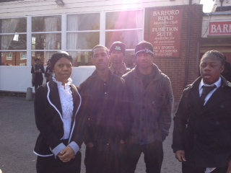
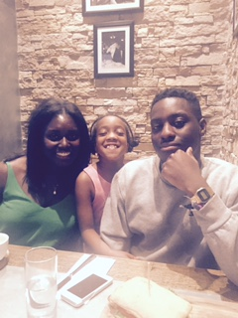
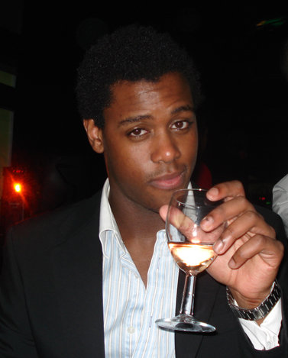
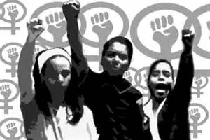
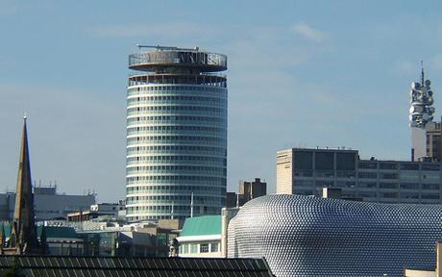

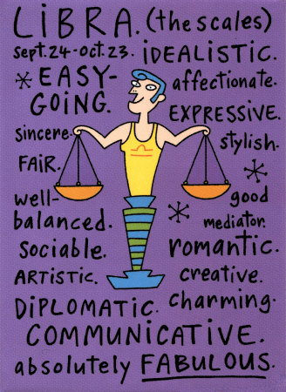
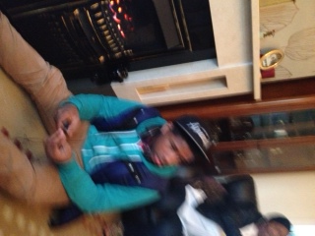
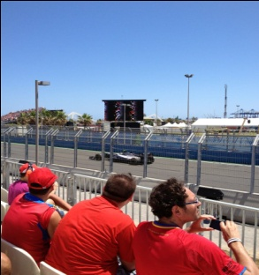
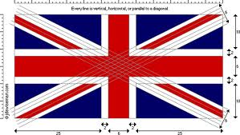


Who am I?
Aunt
Sister
Mother
Mother
Black Feminist
Brummy
Formula one fan
Aunt
British
Aston Villa supporter
Jamaican Heritage
Academic
Notes:
My thesis would be very different if I had decided to remain invisible or taken a position with the expectation that I remained the ‘objective’ bystander distant from the issue under investigation. The contribution of the methodological approach informing this thesis is that it illuminates what is missed when we are absent from the work we do. My thesis allows for further insights about the choices I have made at each stage of the process and how these choices inform both the ‘doing’ and ultimately the ‘knowledge’ stemming from it. Adopting an auto/biographical approach to writing my thesis allows me to illuminate how the data reflects aspects of my own lived reality, my philosophical stand point, my ontological self and how I engaged in the construction of knowledge. Indeed, auto/biography facilitates’ my partial presence in a wider story. I am able to share an understanding that illuminates my insider position about the systematic failure (Structure) and the restrictions this imposes on the individual (agency).

Slide 4
What is understood by the term ‘Urban Gun Crime’?
There is no uniform or overarching definition offered for how we understand the term ‘UGC’. In the UK, ‘UGC’ is a generic term routinely used to encompass all instances in which firearms which may include shotguns, airguns and imitation firearms are used illegally.
Further, it is a term not only used in relation to the illegal use of a firearm, but is also used in association with the illegal possession of firearms (Silvestri, et al., 2009; Wood, 2010; Hallsworth and Silverstone, 2009).

Slide 5
Dangerous others…
A political and media driven perception of ‘endemic’ serious youth violence, has led to widespread anxiety about ‘dangerous’ Black youths living in Britain’s major urban localities (Joseph and Gunter, 2011:3).
This has led to a overwhelming focus on:
‘Gun culture’ and/or increasingly ‘gang culture’ are the two central explanations which have shaped policy responses across institutions and remain the bedrock for popular understanding (Hallsworth and Silverstone, 2009).

Slide 6
Media…
Inevitably, the high incidence of family breakdown in the black community leaves thousands of boys with no male role model, no discipline at home and no moral compass with which to navigate the troubled waters of a South London adolescence… The fact is that no one in the police wants to talk about gang warfare in South London, because the last thing senior officers want is to give credibility to this breed of savage young men who are capable of horrific violence unfettered by the most basic concepts of morality.
Richard Price, Daily Mail

Slide 7
Subject matter of coverage of black young men and boys in print and broadcast news (n=499)
Notes:
An image employed within the media is to characterise black men as existing on the fringes of family life, as lazy, feckless, unreliable, sexually irresponsible, and undeserving of their female counterparts. Whilst in contrast the second image characterizes the Black woman as the strong, single and independent superwomen. It is possible to suggest that the portrayal of Black women holds a number of contradictions as we are also portrayed as ineffectual mothers, promiscuous, etc. Nonetheless, the overall portrayal of Black family life in the media tends to encompass a range of negative stereo types. For example, this can be seen in an article written by Richard Price who states that:

Slide 8
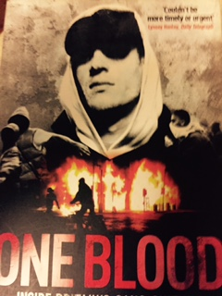
Academic Research
A dominant conceptualisation of ‘UGC’ has been supported by research
Plethora of evidence which helps to perpetuate public and media perceptions that the UK has become the gun capital of Europe, in terms of the propensity for such crimes to occur when compared to the UK’s European counterparts.
This has legitimated comparisons of the current situation in the UK with trends witnessed in the USA (Hales, 2006; Pitts, 2007; Bullock and Tiley, 2008; Pitts, 2008).

Slide 9
Political response
Legislative Changes (punitive sentencing for various firearm offences)
Preventative Strategies (Public and Community based)
Increased scrutiny (identification of those perceived to be potentially at risk)
Home Secretary, Teresa May:
The Coalition Government is determined to identify measures that will be most effective in curbing gangs and the culture that breeds them… we cannot allow ‘gangs’ to continue to spread violence and erode decent civilised behaviour (HMO, 2013: 6)
Notes:
. And as Operation Trident and Razorback are testaments to how Black communities in Britain are still subject to heavy, racially targeted policing tactics.

Slide 10
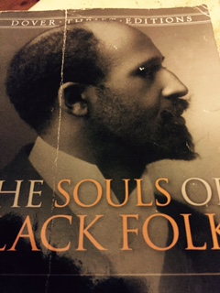
Recasting of Black communities as a problem
Between Me: and the other World there is ever an unasked question: unasked by some through feelings of delicacy; by others through difficulty of framing it. All, nevertheless, flutter round it. They approach me in a half-hesitant way, eye me curiously or compassionately, and then, instead of saying directly, How does it feel to be a problem? They say, I know an excellent coloured man (sic) in my town, or I fought at Mechanicville; or do not these Southern outrages make your blood boil? At these I smile, or am interested, or reduced the boiling to a simmer, as the occasion may require. To the real question, how does it feel to be a problem? I answer seldom a word (Dubois, 1903:1)
.
Notes:
This linkage between ACF and crime in the UK is not new (see Hall et al, 1982). As noted in Chapter One, what is new is a shift in which now we see the confirmation of a link between a specific type of firearm offence and Black communities. Black family life is identified as conduit for young people’s involvement in ‘gangs’ and gun related crime, However, within the UK discourses associate with ‘UGC’ are also indelibly aligned and reproduced in contemporary discourses associated with ‘Feral Parents’ (see De Benedictis, 2012) and ideas underpinning notions of ’Troubled Families’ (see Ribbens McCarthy et al, 2014). The outcome of a complex set such discourses associated with families have major ramifications on ACF who are held accountable for the poor socialisation of young people, providing ineffectual parental supervision, offering a lack of male role models, providing poor environment for raising children/ young people and generally answerable for the transmission of an intergenerational culture of criminality (Hirchi, 1969; Hagedorn, 1998; Fleisher, 2000; Jankwoski, 1991; Joseph and Gunter, 2011).

Slide 11
History shows as Squires ( 2007) reminds us that ….
Gun control policies are often not informed by a rationalist policy process which is based on examination of relevant evidence, but is heavily influenced by a highly political (and public) response to particular incidents. Thus the resulting actions tend to be guided by a desire to do something in response to horrific incidents rather than an outcome of research evidence.
Attempts to address gun control are often driven by a particular political and ideological approach which has implications for issues such as individual freedom, citizenship rights and social discipline.

Slide 12
Methodology
My research was designed using an interpretivist framework.
Critical Ethnography
The need to consider research participants in a wider context
To focus attention on wider structural relations and its relationship to the social processes implicated in the lives of participants
The production of a dialectical analysis as a means of deconstructing social structures
Black Feminism
It takes place within interpretative frameworks,
It adopts an epistemological stance
It allows for insights concerned with empowerment,
And, it reflects and aims to shape specific political contexts confronting Black women (Hill Collins, 1990).

Slide 13
Interviews
Pseudonym Respondent | Role | Faith based | Locality | Gender
Paul | Community Worker | No | Area 1 | M
Robert | Chief Executive | No | Area 2 | M
Martyn | Lecturer / Community Worker | No | Area 1 | M
Susan | Civil Servant | No | Area 1 | F
Alison | Anglican Vicar | NO | Area 2 | F
Kyle | Radio Presenter | No | Area 2 | M
Samuel | Community Worker | Yes | Area 2 | M
Vincent | Community Worker | No | Area 2 | M
Ronald | Community Worker | Yes | Area 2 | M
Shirley | Probation | No | Area 1 | F
Anna | Health professional | Yes | Area 1 | F
Rachel | Youth Worker | No | Area 2 | F

Slide 14
Key findings : Motivation for getting involved in community activism UGC was something personal and political
It is my experience of being stopped in the supermarket by a parent. Literally the last time is about three weeks ago by a mum who is telling me that her son is keeping bad company and then she goes onto talk about what that bad company is. The youngsters he is hanging with are known for being involved with guns and knives and so on. So because of my involvement of community work in the past in the city I have people stopping in the streets literally or I get a phone call three o’clock in the morning saying something is going to kick off what can we do. So I’m informed by what I see myself and also what other people in the locality tell me (Paul).
Notes:
For community activists community held a number of meanings and expressed something about how participants felt about their sense of connection with each other and their connection to the issue of ‘UGC’.
Father and mothers shared first hand experiences
Participants spoke about their involvement being influenced by
Past and ongoing involvement in community activism
Faith
Personal experience
Feeling they could contribute something due to their professional status

Slide 15
Key findings : Motivation for getting involved in community activism UGC was something personal and political
I know it is going to be a tall order because there is a lot done to us historic, but I am held by God! ....God has given me an amount of time on the earth, without going to deep into stuff, but I have a new perspective and I have been called here to serve and, he’s given me whatever my gifts are to operate and function at this time in this age until he says it is time (Ronald).
I have been to funerals to men who have died to ‘gun crime’, gang violence. I have been to mums to let them know that their sons have passed away and to see how they are doing. I have been to people who have come ready to do damage to other people. I have seen people who have been crying for years who have lost a friend and the friend’s murderers have never been found. So this is a real issue here (Samuel).

Slide 16
Key findings : Motivation for getting involved in community activism UGC was something personal and political
I have got a twenty five year old, a twenty four year old and a nineteen year old. My twenty four year old has been to prison, my twenty five year old is currently in prison and my nineteen year old is toughing it out. So for me it is not... I am not doing it because my nippers are involved; I started it in 1998. I am doing it because it is my duty more now because I have no choice (Martyn)
I have been harassed by the Police. They have even pointed a gun at my head. They started to come to my house with guns. I reached a point where I nearly had a nervous breakdown. I would be sitting up all night. They came one night, can we come in? As soon as [Son] came down stairs they arrested him (Rachel) .

Slide 17
Key findings: Motivation for getting involved in community activism UGC was something personal and political
I engage with it from maybe a slightly detached place which is not detached really …but people tell me I think that I am middle class …But if middle class means you have lots of money then clearly that ‘s not me because I ain’t arrived there yet. But suppose, you know, kind of socially where you are in the pecking order. I am not of the street and I wouldn’t claim to be from the ‘hood’ in that sense (Kyle).

Slide 18
Key Findings: Acceptance and resistance to the dominant conceptualisation of ‘UGC’
For me it is a personal thought really and a personal opinion ... I feel there are too many broken families, particularly where the boys are. Unless they have had some sort male influence from maybe mum’s brother or positive guys in the neighbourhood they are likely to stray (Martyn).
There are two things that are very very prominent it is over simplified in the sense that a Black guy or a black youth is going to be a drug pusher or a gang member and the questions is why. There are two main reasons I believe as to why that is the case; A lack of educational support and achievement. The system does not support Black boys to achieve and the statistics bear that out, so the education and the lack of equipping our young people with the right skills to cope with life (Robert).

Slide 19
Key Findings: Reproduces notions associated with ‘race’
I just think with the Black family we are pathologised, we’re like a pathology it’s not like we’re a family… I don’t watch TV much, but you don’t see the image of a Black man and women and children so with you know with the media I think it is their interest to portray us as being dysfunctional. The Black woman strong domineering ...who is strong and don’t need a man and that is what the media does and we buy into that stereo type and we use that to describe our self.... We are all dysfunctional even where there is a situation where there is a family unit they still think we’re dysfunctional... They have to see us that way because that allows them to treat us the way they do and it justifies some of the things that they do on to us and you know...? (Anna).
Notes:
Despite ‘UGC’ being identified as the principle issue and reason for participants coming together either as part of a community initiative, meeting, event or indeed for agreeing to participate in an interview, ‘UGC’ in itself was seldom the principle focus of attention. ‘UGC’ was a catalyst for men and women from ACC to come together and, in coming together create and occupy a space to share their perceptions, experiences and to engage in a dialogue. Central to discussions was a perception that ‘UGC’ was both located and symptomatic of wider injustice and inequality. My observational notes record a myriad of ways in which participants spoke about their racial and racialised identity, the extent to which they felt included and excluded from wider society, insiders yet also outsiders and treated fairly or unfairly. Consequently, participants’ narratives moved beyond the issue of ‘UGC’ to tell an alternative story about their lives and their experiences of ‘race,’ racism, racialisation and the process of criminalisation, and it is these factors which are paramount to the sense of collective endeavour and in the conceptualisation of ‘UGC’.

Slide 20
Key Findings: Racialisation
What has really happened over the last ten years particularly is the way that gun is synonymous with Black has had an impact on Black people who now know that my child, my son as a Black boy is going to be perceived by society as a gang member that is the impact it has had. Just like within the Asian community they know that they are perceived as potential terrorists even though we know that that is not the case in every instance. So that is the big impact that it has had in that we are not only stigmatised not only now has being thick, not only now has being drug pushers, not only now as being gang member but also has being potential shooters. So that just adds to the list suppressing the Black community and makes a challenge in trying to educate your child and keep them motivated. And then once you have got through all of that and then up for it; that you know within your heart, when they sit in front of a potential employer, or they go to apply for a course or whatever that they are going to be perceived by society as fitting in to that category. And that has an impact on you as an individual and you as family so you are always trying to protect your child and trying to steer them away from those kind of things on a personal level but you realise that there is something out of your control that really frustrates the life out of you that society now has within their mind a view of your child and that has a mental impact on you but it also has a physical one (Robert)

Slide 21
Key Findings: Racism
Now that certain words aren’t politically correct, it is doesn’t that the impact is any different or that it has gone away but, it just that it is more covert now. You know? You are feeling the effect! You go somewhere and you pick up the vibes and you look at what happens with our children in schools, it is still there, it is not as blatant, but the impact it is worse and because people can’t see it (Angela)

Slide 22
Key messages for this session and beyond …
Focusing attention on ‘race’ racisms and the process of racialisation.
Understanding the diversity to be found within Black communities
Deconstructing terms and concepts used.
Recognising that there is much to learn when we provide safe spaces for people to talk about their lived experiences and share their views
Accepting that there are multiple ways of knowing
Being accountable for the knowledge produced.

Slide 23
Please lets not forget …
Individuals who have died from a racially motivated attack since the death of Stephen Lawrence in 1993.
1993: Saied Ahmed and Ali Ibrahim. 1994: Shamsuddin Mahmood, Donna O’Dwyer and Mohan Singh Kullar. 1995: Mushtaq Hussain. 1996: Daniel Blake and John Reid, 1997: Michael Menson and Lahkvinder ‘Ricky’ Reel. 1998: James Tossell, Akofa Hodasi, Remi Surage, Surjit Singh Chhokar and Farhan Mire. 1999: Jay Abatan, Stelios Economou, Harold (aka Errol) McGowan, Liaquat (aka Bobby) Ali, Joseph Alcendor, Ben Kamanalagi, Hassan Musa, Zardasht Draey and Jason McGowan. 2000: Zahid Mubarek, Santokh ‘Peter’ Singh Sandhu, Komra Divakaren, Jan Marthin Pasalbessi, Glynne Agard, Mohammed Asghar, Abdi Dorre, Tariq Javed, Khaliur Rahman and Sarfraz Khan. 2001: Gian Singh Nagra, Fetah Marku, Shiblu Rahman, Sharon Bubb, Firsat Dag and Ross Parker. 2002: Frankie Kyriacou, Peiman Bahmani, Shah Wahab, Derrick Shaw and Israr Hussain. 2003: Mohammed Isa Hasan Ali, Unnamed Asian man, Paul Rosenberg, Johnny Delaney, Awais Alam and Quadir Ahmed. 2004: Kriss Donald, Shahid Aziz, Akberali Tayabali Mohamedally, Brij Brushan Sharma, Bapishankar Kathirgamanathan and Kalan Kawa Karim. 2005: Deraye Lewis, Mi Gao Huang Chen, Mugilan Sutherman, Kamal Raza Butt, Anthony Walker, Rushi Kamdar and Isiah Young-Sam. 2006: Lee Phipps, Christopher Alaneme, Khizar Hyat, Hamidullah Hamidi, Mohammed Pervaiz, Changez Arif, Shezan Umarji, Wei Wang, Syed Sorafot Ali and Meshack Brown. 2007: Enayit Khalili, Tarsen Nahar, Marion Moran, Adam Michalski, Gregory Fernandes, Ahmed Hassan and Asaf Mahmood Ahmed. 2008: Hamida Begum, Alana Mian, Nilanthan Moorthy and Mohammed al-Majed. 2009: Syden Pearson, Kunal Mohanty, Marek Muszynski and Ekram Haque.2010: Papa Mbaye Mody (aka Alioune Cisse), Mohammed Idris Mirza, Marcin Bilaszewski, Nachhattar Singh Bola and Simon San. 2011: Mahesh Wickramasingha and Anuj Bidve.

