Slide 1
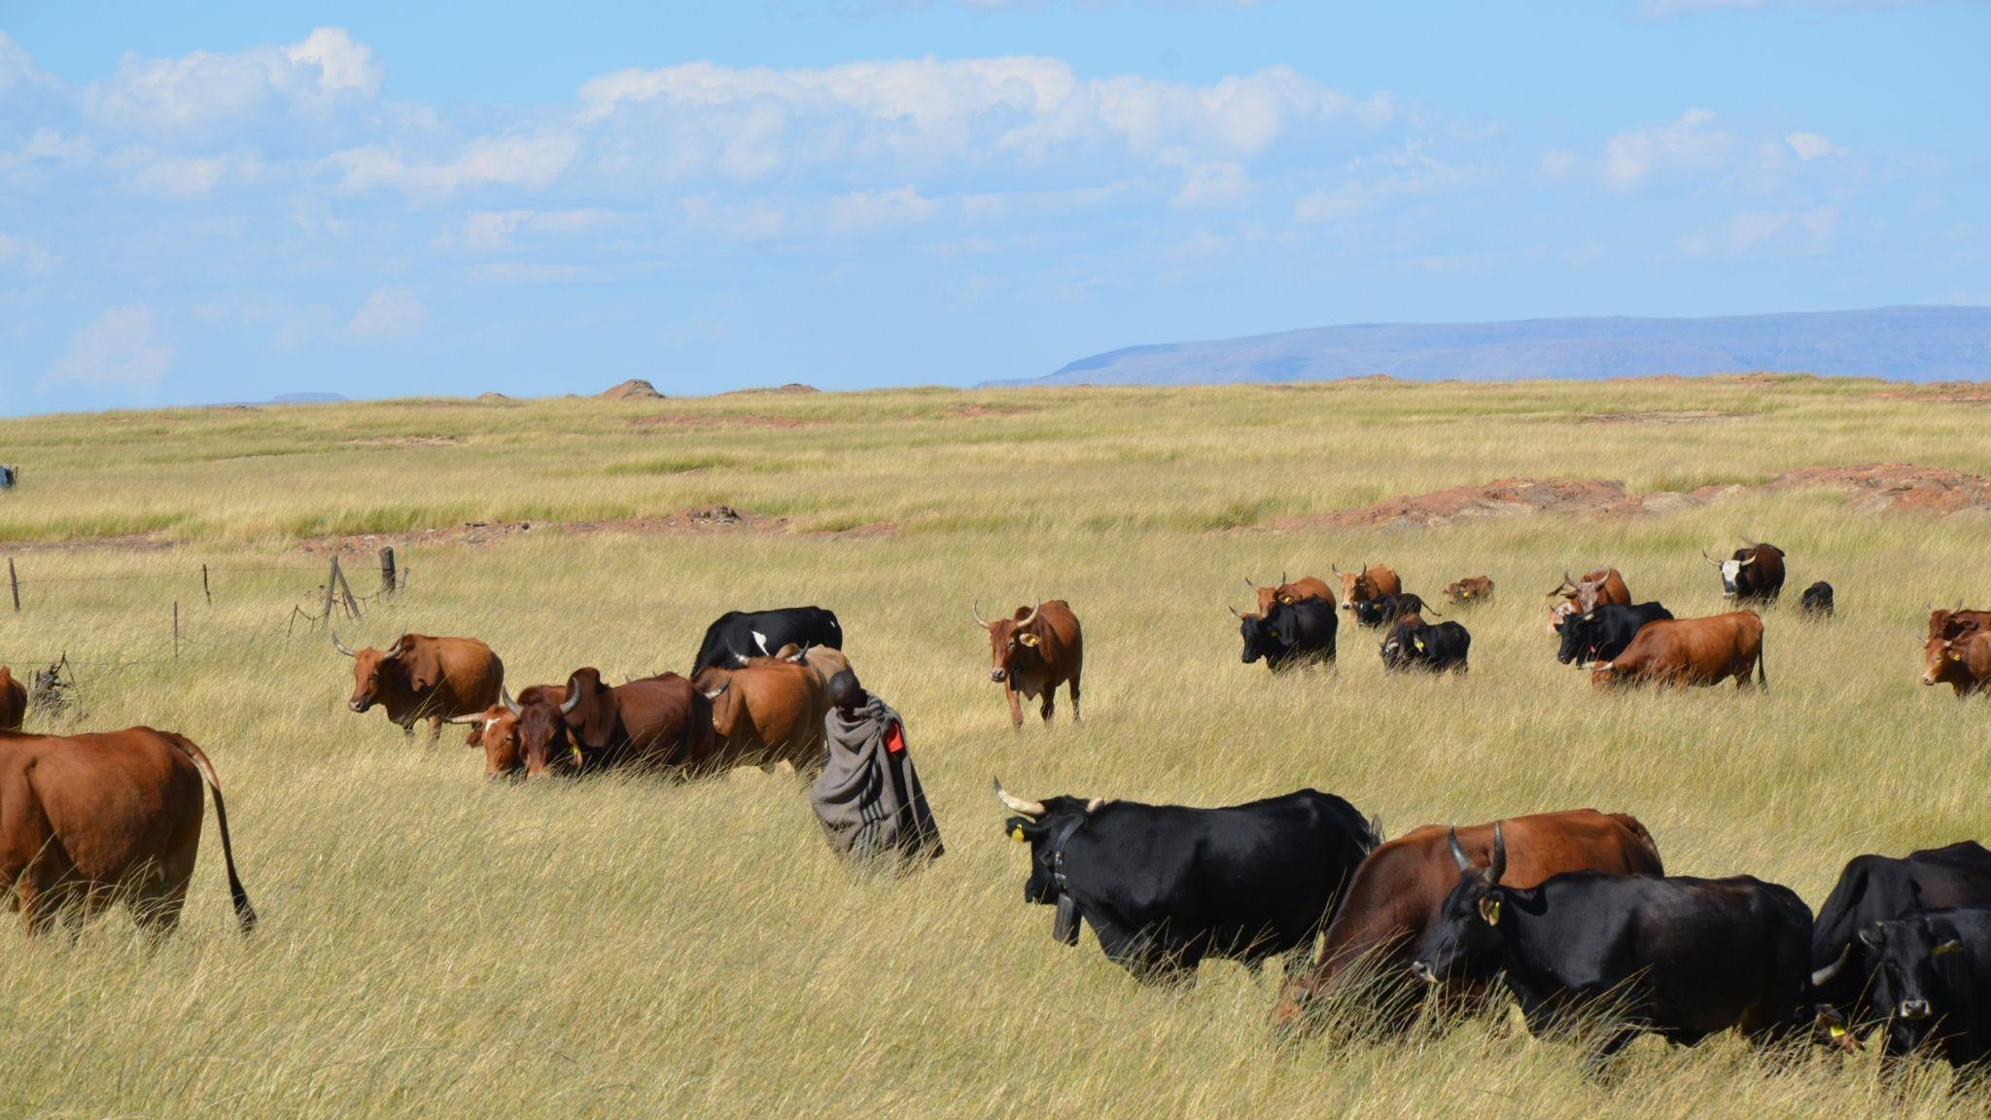


models as discussion points for better land use plans
Heidi-Jayne Hawkins^{1,2*}, Mostafa Moradzadeh³, Lianhai Wu³
¹Conservation South Africa, ²University of Cape Town, ³Rothamsted Research
TOCASA Stakeholder Meeting 2022

Slide 2
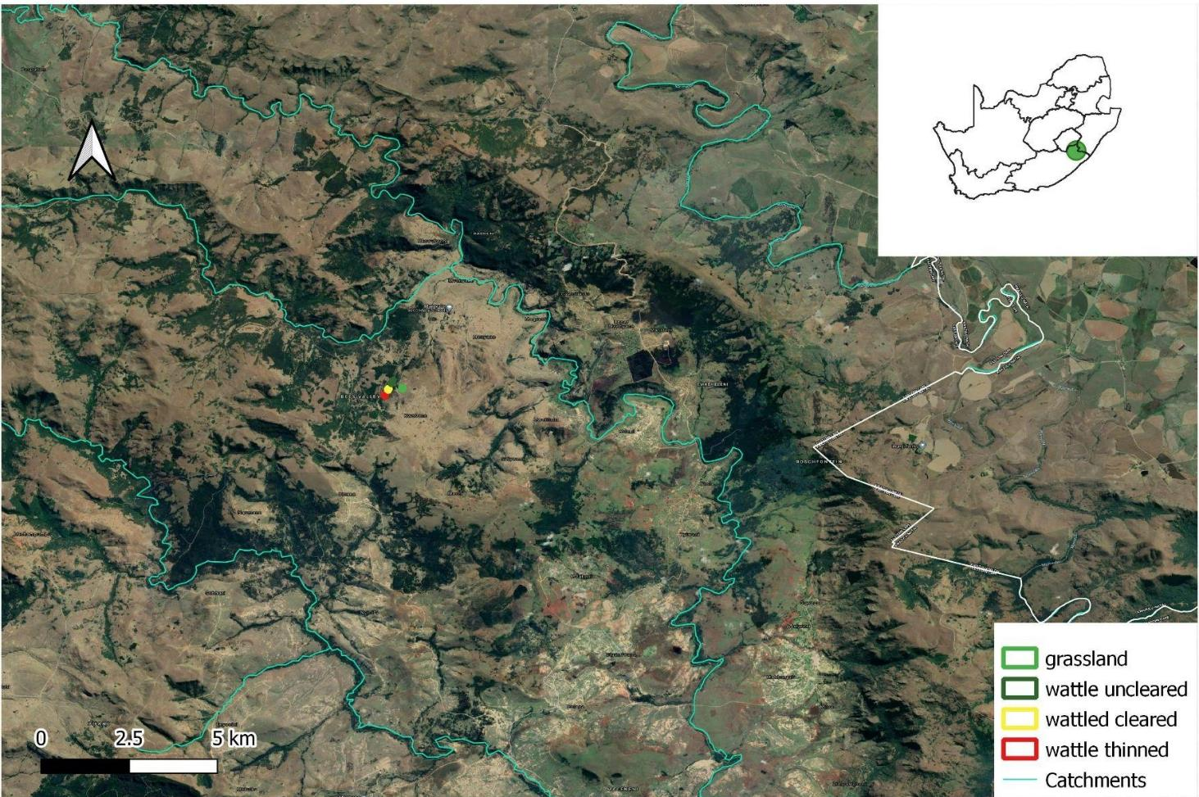
COMMUNAL GRASSLANDS VALUABLE BUT THREATENED
Grasslands provide ecosystem services and livelihoods
Threatened by unplanned grazing and fire, erosion, invasive plants, climate change
Can planning grazing and planned fire increase grass cover (and livestock weight gain)?
More grass roots means more soil carbon and this could earn communities carbon credits (income)
Notes:
James would have mentioned ESS already. Perushan already talked about wattle. …Kering project by CSA is already investigating carbon credits

Slide 3
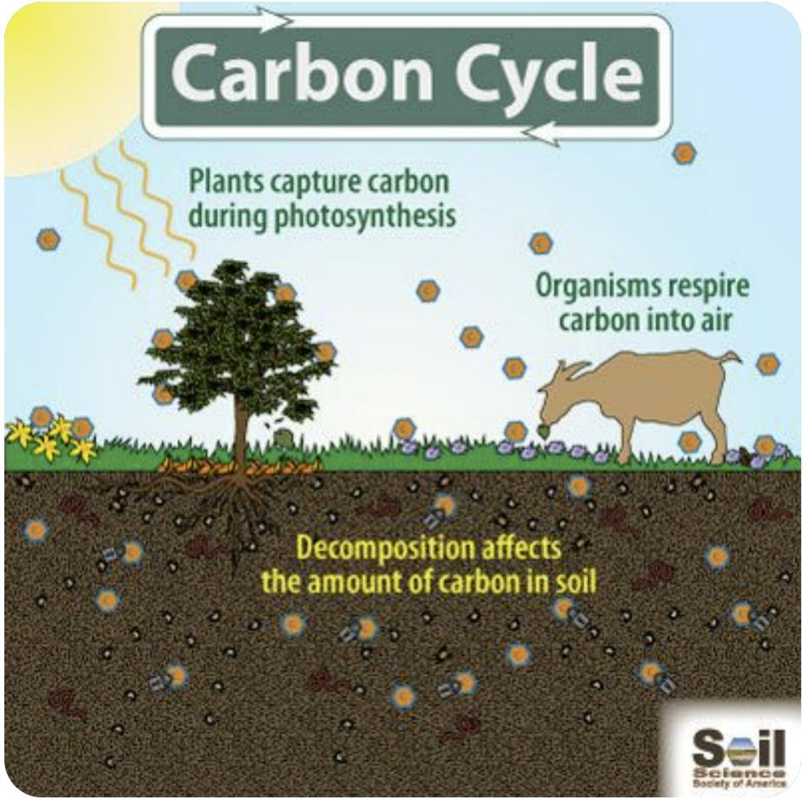
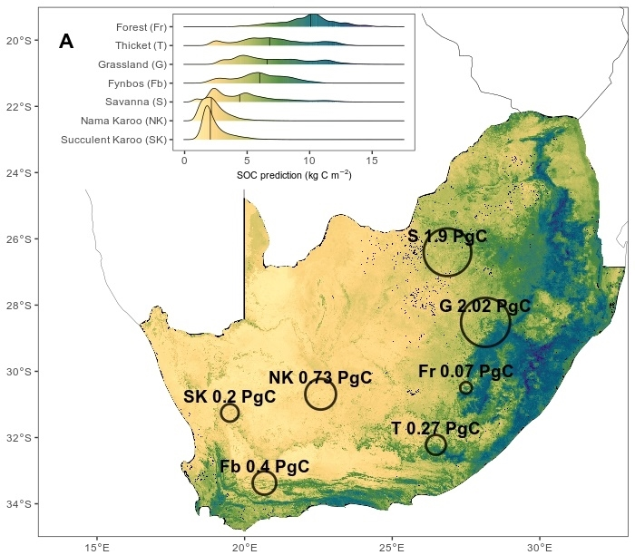

GLOBAL WARMING: C as one GHG
We focus on carbon in this presentation:
Total ecosystem carbon = SOC + Biomass (above/below) - Respiration
SA grasslands: Greatest extent & overall SOC content
Venter et al. (2021) https://doi.org/10.1016/j.scitotenv.2021.145384

Slide 4
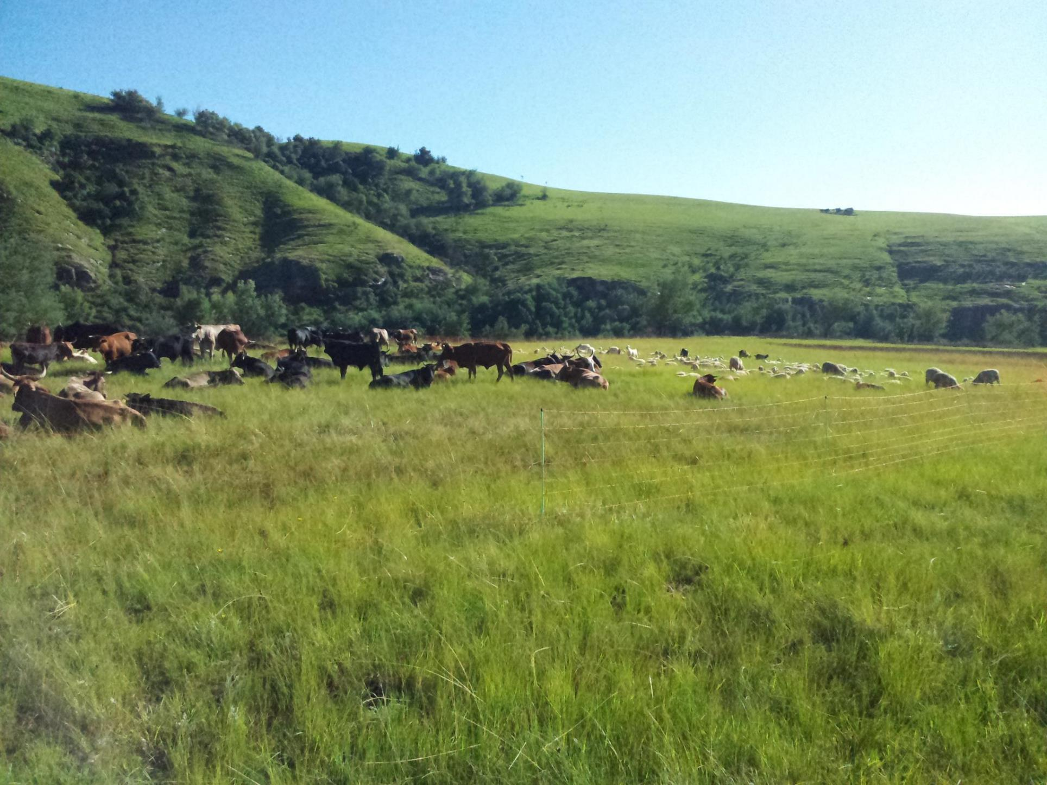
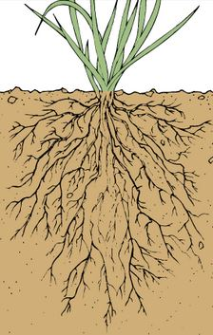

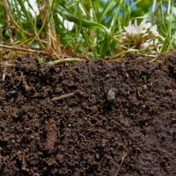
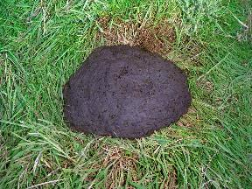
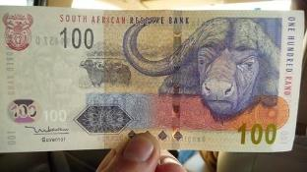
Recommended stocking rate (0.25 LSU ha⁻¹) promotes grass growth
Rotational grazing 2-4 camps (maboella) allows grass shoot and root to grow/recover
ROOTS
This Photo by Unknown Author is licensed under CC BY-SA-NC
RESTED AREA
Moderate fire adds carbon to soil
This Photo by Unknown Author is licensed under CC BY-NC-ND
FIRE
SOC
GRAZED AREA
Increased root growth means increased soil carbon, climate resilience
Dung adds carbon to soil
DUNG
This Photo by Unknown Author is licensed under CC BY
Carbon finance?
Notes:
Wang et al 2018, 2020 re stocking rates and root growth and resting https://www.sciencedirect.com/science/article/abs/pii/S0048969720326097

Slide 5
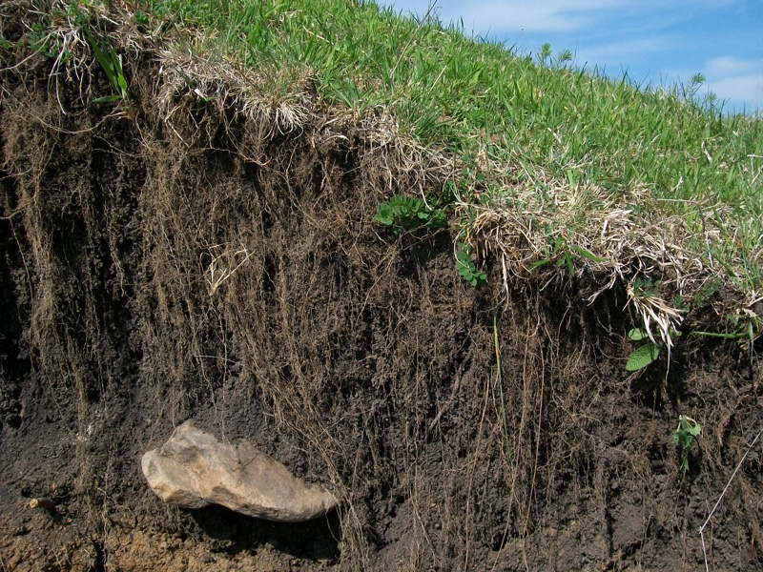

Slide 6
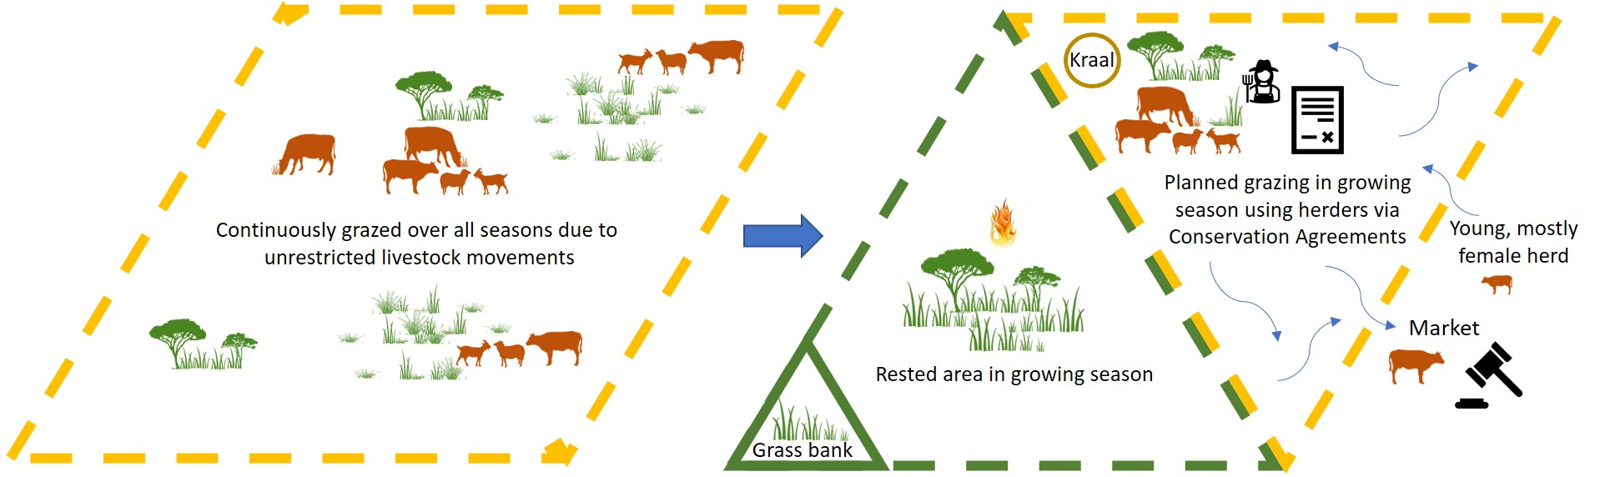
CONSERVATION AGREEMENTS INCLUDING ROTATIONAL REST FOR INCREASED GRASS PRODUCTION (AND SOIL CARBON?)
Notes:
Conservation South Africa works with communities via CAs to restore grasslands where shift from continuously grazed unrestricted livestock movements to planned grazing with rested and grazed areas, in exchange for incentives such as training, forage, vaccinations and market access

Slide 7
With rest, we expect grass and livestock production, and soil organic carbon to increase with better practice
What is better practice? We adjust rotational rest based on monitoring veg and soil. It would be convenient to try out with different stocking rates, number of camps, and fire regimes without risk or taking many years
  Mathematical models useful for predicting what can happen many years in the future, also with different climates
  Models need real monitoring data as inputs and to check model outputs before used to forecast. Then can evaluate different land uses under different future climate scenarios
  Two similar models with different merits:
    DayCent – grassland/savanna model that predicts fire well
    Spacsys - agricultural model that predicts animal production

Slide 8
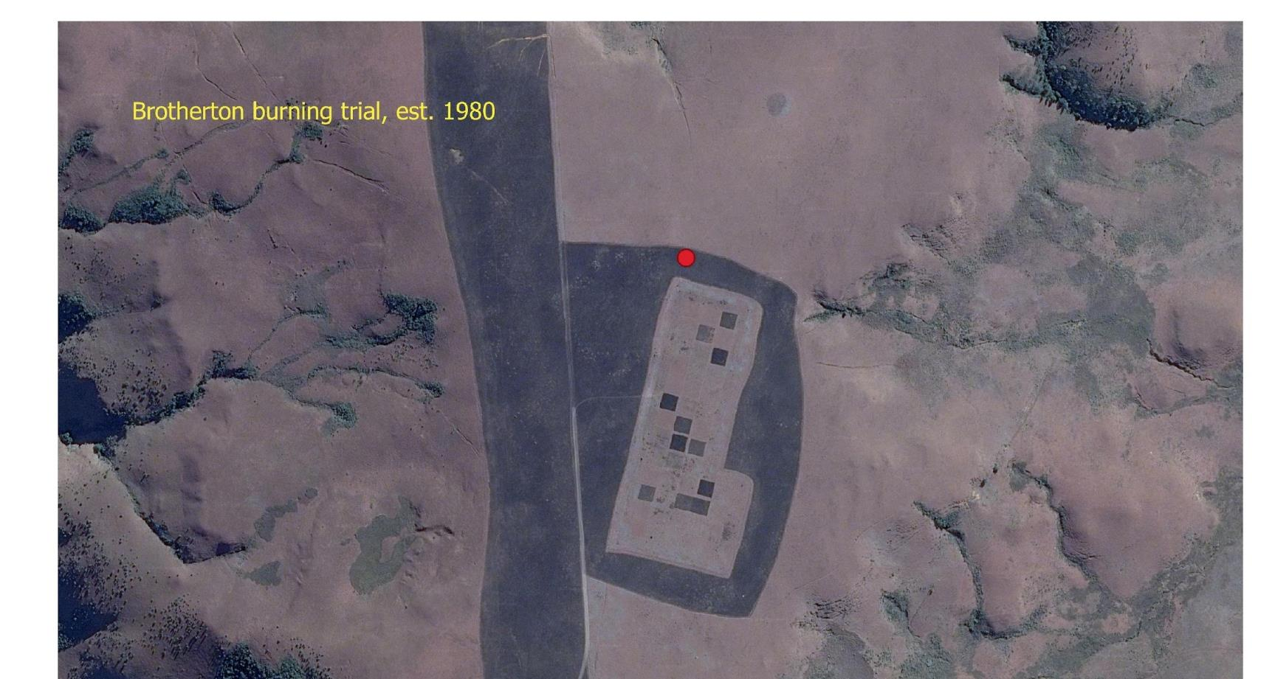
MODEL DEVELOPMENT
Long term experiments in the grasslands of the Drakensberg help us develop the models, but we also need local data in Mvenyane to do this
Notes:
We used an experiment in Drakensberg to help set up the models and make sure they are performing well. If anyone here has an interest in how this was done please contact us in the tea break. For today we will focus on showing you the results of the modelling that can be helpful in deciding on actions for land use.

Slide 9
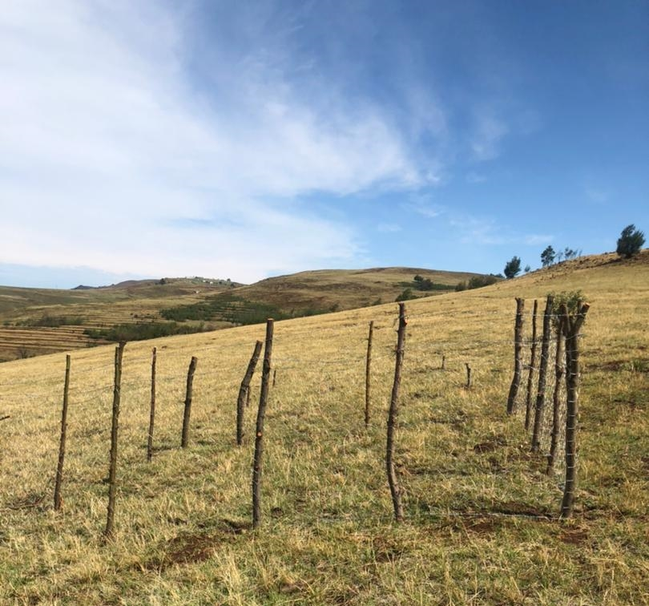
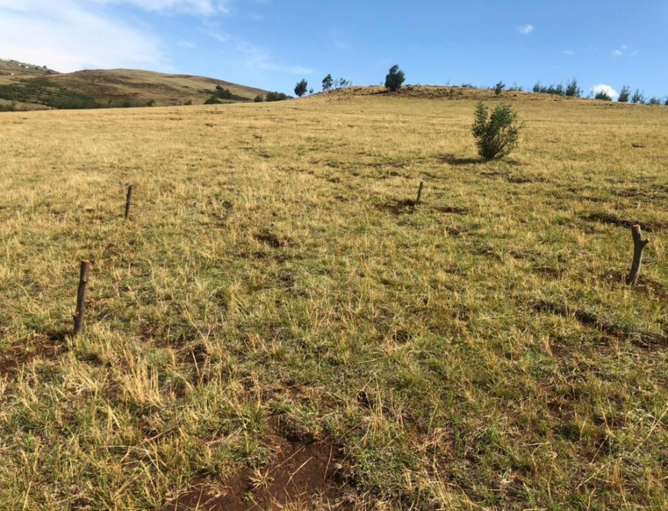
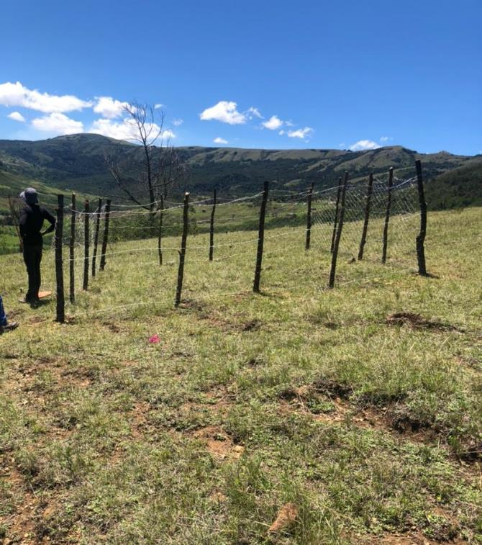
MONITORING used for MODEL DEVELOPMENT and VALIDATION
Gwadane
Gwadane
Mabheleni
Rested and unrested camps, as well as exclosures help us monitor condition of rangelands but also provide data for models to see that they can predict what we know already, then can use them to predict things we don’t know. Our models were validated and will focus on predictions over 20 years from 2021-2040.

Slide 10
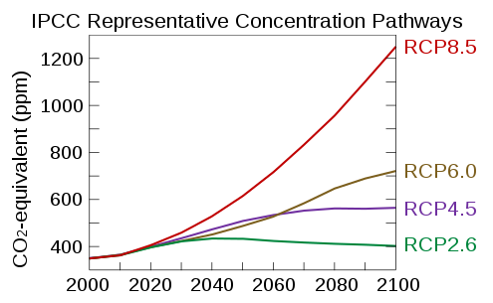
SCENARIOS
Rotation | Alternative name | Grazing Frequency in growing season |  | Rest in growing season (months /2 yr)
 |  | Camp 1 | Camp 2
None | Continuous | 1 Oct-30 June | N/A | 0
Annual (maboella) | Season-long | 1 Oct-30 June | Oct, May | 10
Quarterly | Quarter-long | Oct-Dec; Apr-June | Jan-Mar; July-Sept | 12
Future climate | Temperature increase 2081-2100 (deg. C)
RCP 2.6 | 1
RCP 4.5 | 1.8
RCP 8.5 | 3.7
Grazing pressure | Livestock units per ha
None | 0
Low | 0.25 (recommended)
Medium | 0.75
High | 1.47
Fire frequency (medium intensity, biomass based)
Annual | too frequent
Triennial | recommended
Notes:
Check if Daycent can specify the CO2 for RCPs

Slide 11
[CO₂] PREDICTED to INCREASE causing GLOBAL WARMING and PRECIPITATION changes
Future climate | Temperature increase 2081-2100 (deg. C)
RCP 8.5 | 3.7
RCP 4.5 | 1.8
RCP 2.6 | 1

Slide 12
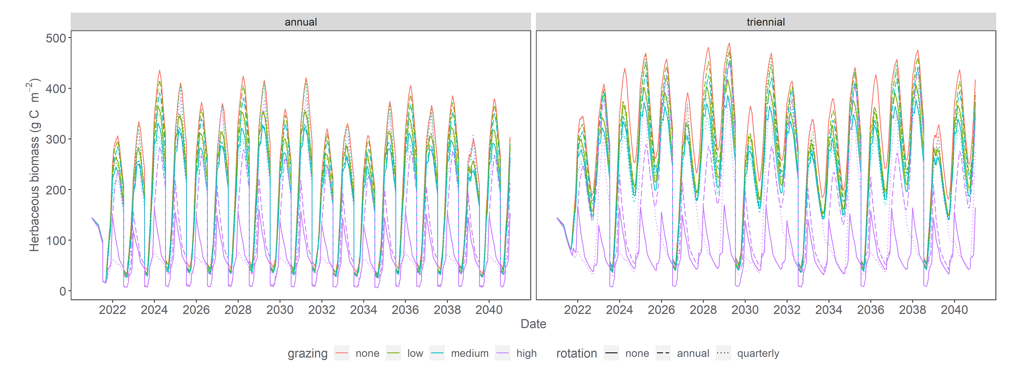
GRASS PRODUCTION (DAYCENT, RCP 2.6)
Notes:
Shows seasonal variation. But not so clear so we remove seasonal component to see the trend and diffs between treatments (nxt slide)

Slide 13
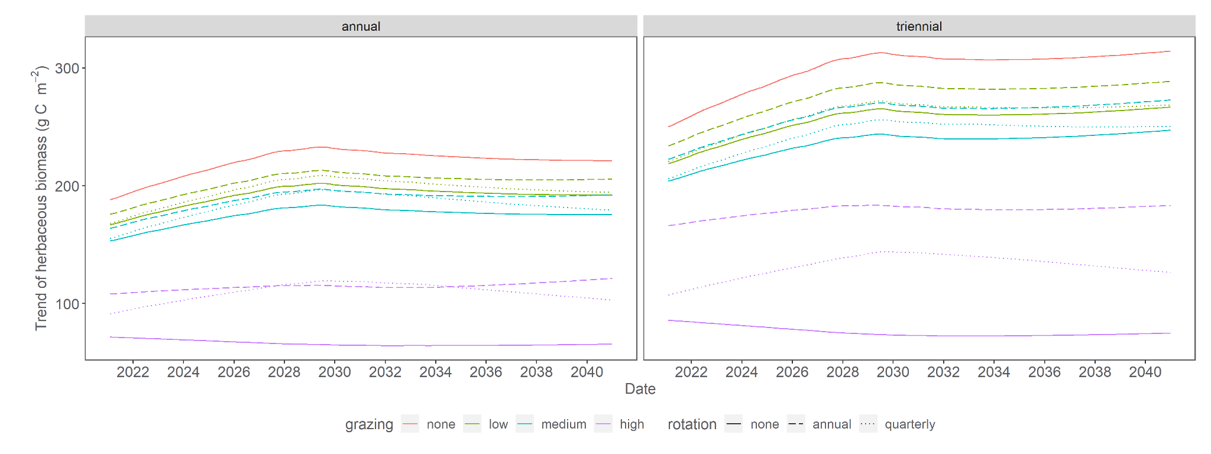
TREND grass production (DAYCENT, RCP 2.6)
This is possible with rest and lower stocking
Additional 200 g C m⁻² (or 4500 kg grass per hectare)
Notes:
Same data just smoothed with season removed: Explain axes and legend…
First let’s look at FIRE (left is annual right is triennial): annual fire <<< triennial fire and fire frequency in the area is generally every 3-5 years but as we know they can be unplanned with tragic losses.
Second let’s look at STOCKING RATE (all the solid lines) NO grazing >> low >> med >> high as might expect, this is well know
Third let’s look at rotation: Annual rotation (2 camp)>>Quarterly (4 camp)>>no rotation (continuous). Interesting is how rotation makes bigger diff as increase stocking rate
Overall highest grass production with triennial fire, low (recommended) stocking rate and annual rotation (rotational rest).
At moment we are here (show actual data), and with rest and lower stocking (do we know stocking??) we could gain as much as 4500 kg/ha according to model

Slide 14
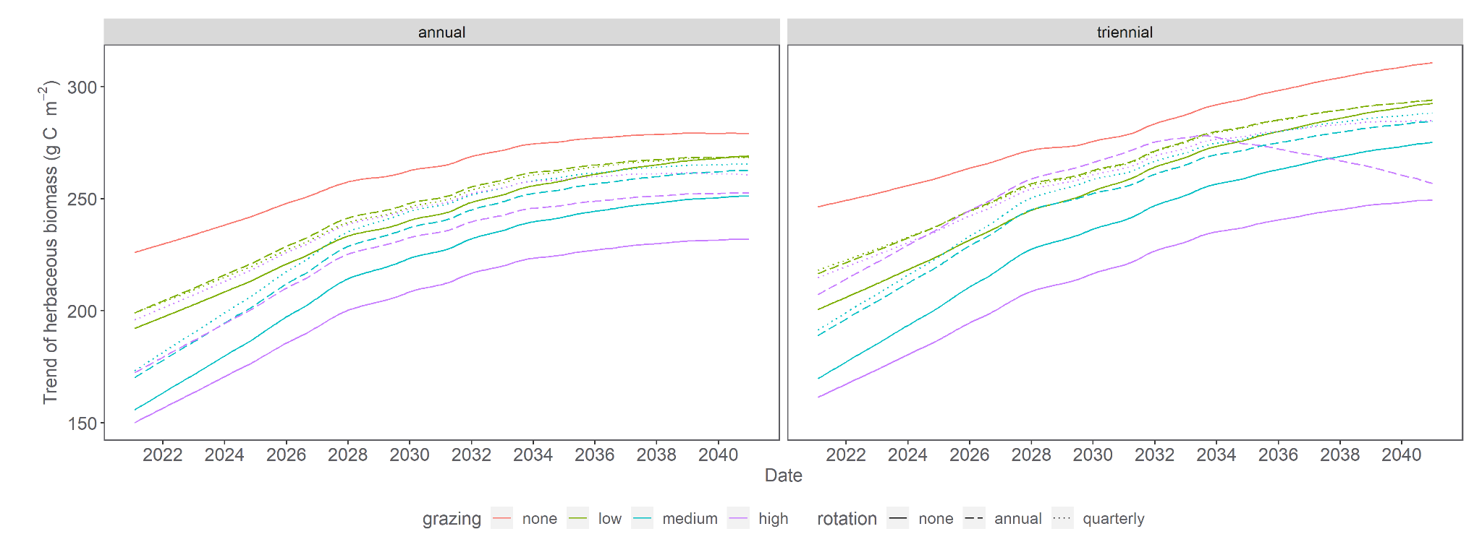
TREND grass production (SPACSYS, RCP 2.6)
Notes:
Grass production - Spacsys model: Explain axes and legend…Here we see highest amount of grass is produced with moderate fire (every 3 years), low (recommended) stocking rate and annual rotation (rotational rest)

Slide 15

GRASS PRODUCTION favoured by
GRASS PRODUCTION
‘Low’ stocking rates (0.25 LSU ha⁻¹ - recommended)
‘Annual’ rotation (maboella/rotational rest/season-long)
Moderate fire (every three years not annual) – start to consider planned burns?

Slide 16

CATTLE PRODUCTION (kg /animal) OVER 20 YRS (SPACSYS, RCP 2.6)
 | STOCKING RATE | MEDIUM | HIGH
ROTATION | Low (0.25 LSU/ha) | Medium (0.75 LSU/ha) | High (1.47 LSU/ha)
None | 373 | 371 | 355
Annual | 371 | 371 | 360
Quarterly | 407 | 406 | 392
Standard error about 0.9-1.0
Fire is triennial

Slide 17

SHEEP PRODUCTION (kg /animal) OVER 20 YRS (SPACSYS, RCP 2.6)
 | STOCKING RATE | MEDIUM | HIGH
ROTATION | Low (0.25 LSU/ha) | Medium (0.75 LSU/ha) | High (1.47 LSU/ha)
None | 66 | 60 | 55
Annual | 64 | 59 | 55
Quarterly | 69 | 65 | 62
Standard error about 0.2 – 0.3
Fire is triennial
Notes:
The best scenario for animals (the other data is available but Mostafa is formatting it for graphing….this is a placeholder so long)

Slide 18
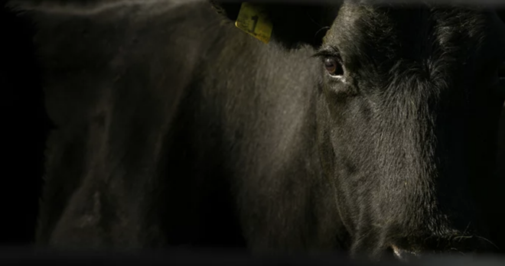
ANIMAL PRODUCTION
High stocking rates decrease sheep and cattle weight gain
Rotation (annual but especially quarterly) increases gain
Rotation allows for sufficient winter forage
Notes:
But as we know SPACSYS cannot similar fire directly so result re fire is uncertain

Slide 19
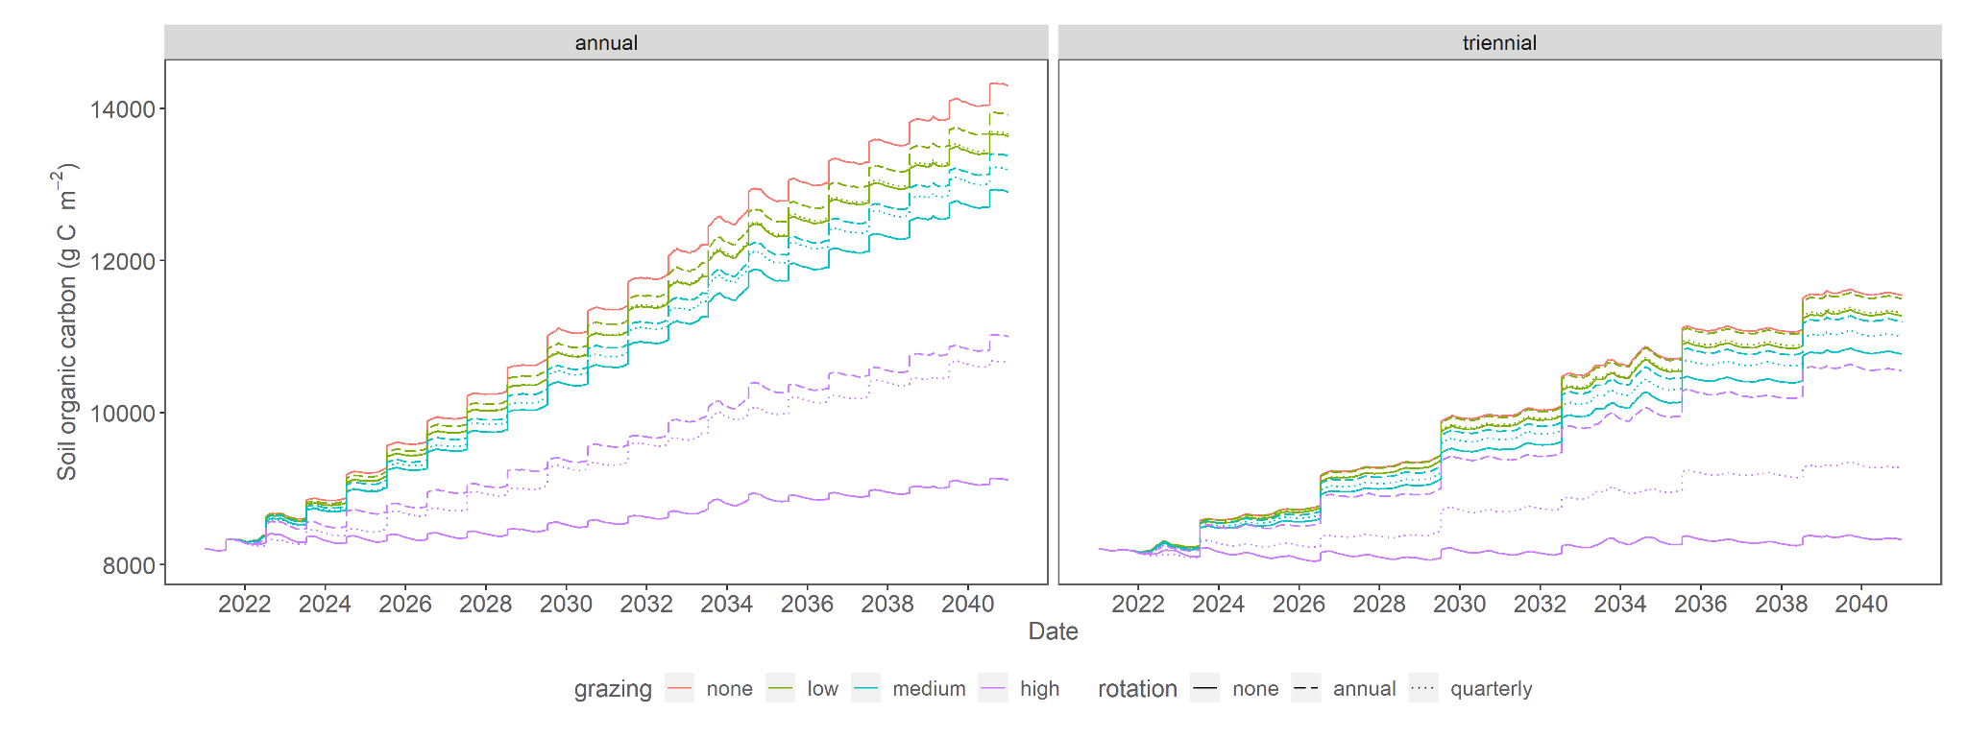
SOIL CARBON IN FUTURE CLIMATE (DAYCENT, RCP 2.6)

Slide 20
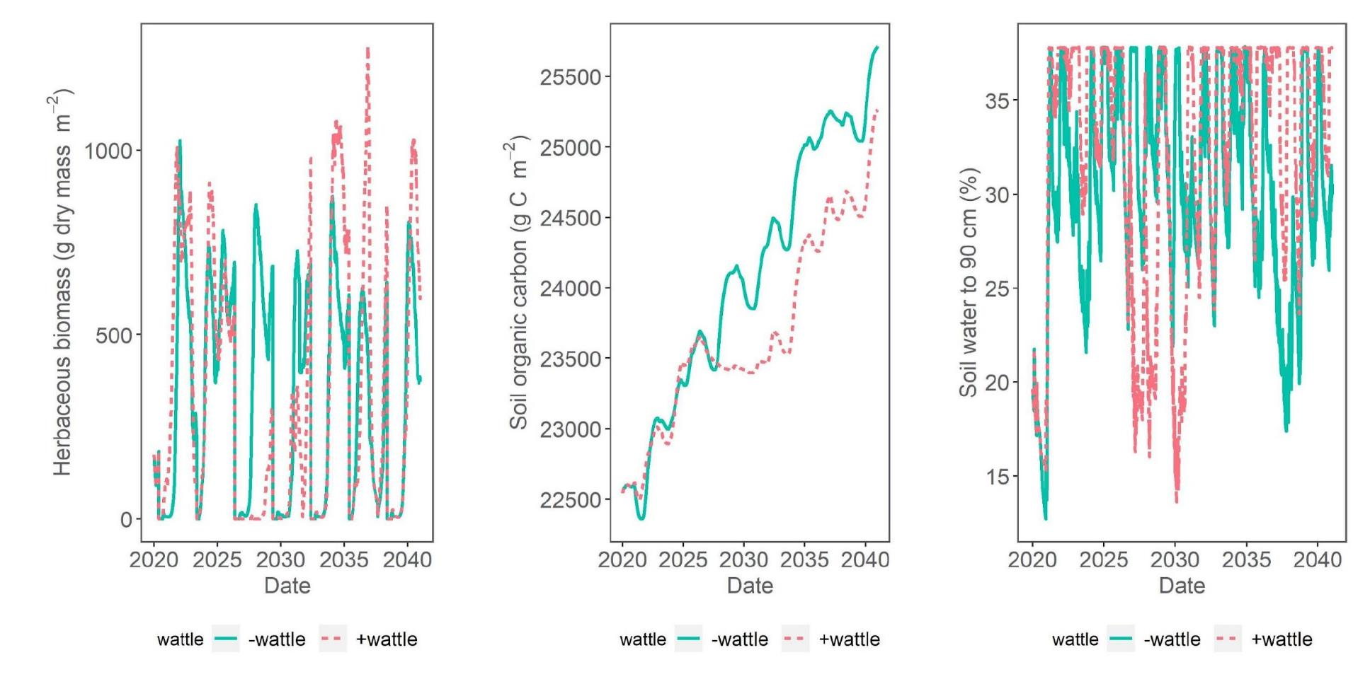
EFFECT OF WATTLE ON GRASS, CARBON, SOIL WATER (SPACSYS)
2-camp, moderate grazing, fire every 3 years in mid May
RCP8.5: High emissions global warming climate scenario (BAU)
Empirical data:
Biomass: Gwate et al. (2016) https://doi.org/10.2989/10220119.2016.1271013
SOC & H₂O: Yapi et al. (2018) https://doi.org/10.1080/21513732.2018.1450291
Notes:
Maybe we show these? Preliminary wattle findings: If we look at one of these planned grazing scenarios….and apply the BAU future climate then my colleague Mostafa has found
Grass biomass without wattle (blue) or with wattle (pink) varies depending on wattle density apply, climate and year of fire. Empirical data (Onnalenna Gwate, Tony Palmer etc show thinned wattle could increase biomass)
Carbon could be lower (lower or higher or same in empirical studies), point is should not assume will be higher under wattle
Water all studies agree lower soil moisture with wattle, only sometimes in model – need work but interesting

Slide 21



SOIL CARBON SUMMARY
Low stocking rates (recommended rates)
Annual rotation (rotational rest or two camp)
Triennial fire (SOC is highest under frequent fire BUT this is not good for grass or biodiversity), so is a trade-off
Wattle could decrease not only soil water but also SOC

Slide 22
MODEL HELP SHOW US WHAT IS POSSIBLE
GRASS PRODUCTION
  Better practice could provide 4500kg ha⁻¹ yr⁻¹ more biomass than present
  Consider planned triennial burns?
SOIL ORGANIC CARBON (20cm depth)
  Better practice could increase SOC stock by 1.75 t C ha⁻¹ yr⁻¹ over 20 yrs
  This amount could qualify for a carbon project, especially one that considers community benefits, biodiversity, and water security
WATER
  Area for future modelling studies
Notes:
Discussion - add implication for other areas, spatial Daycent, utility for partners

Slide 23
UTILITY FOR OTHER AREAS?
The general trends from these processed-based models can be
Applied directly as a guide to surrounding areas with similar soils and vegetation, e.g., upper uMzimvubu catchment, Drakensberg
Detailed studies require local data:
      Weather (daily tmin, tmax, precipitation, wind speed, radiation) from weather station or CHIRPS
  Soil characteristics (percent sand, silt, clay; bulk density, pH) from soil samples
  Biomass over time essential
  Soil N, C, other elements and plant C:N ratios very helpful
Notes:
Discussion - add implication for other areas, spatial Daycent, utility for partners

Slide 24



THANKS
Colleagues: James Bennett, Tawanda Marandure, Anthony Palmer
Contact: Heidi on hhawkins@conservation.org

Slide 25
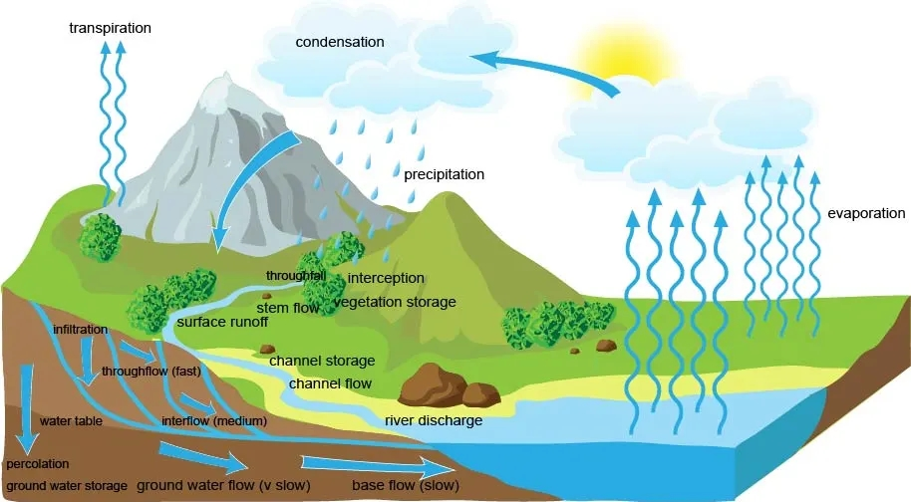
WATER BALANCE
Water Balance (0) = Rain + Soil moisture - Interception - Evaporation - Transpiration - Streamflow (if snow sublimation = 0)
Notes:
Spacsys and Daycent are field level

Slide 26

WATER SUMMARY
Wattle likely decreases soil moisture, also SOC?
Models simulate water flows (ET, streamflow, soil moisture etc) but are at field scale not landscape.
Require hydrological model for landscape flows
Multi models for carbon-water landscape flows
Notes:
The model tell us there is more water drainage and water drainage events with more frequent fires (probably during periods of low vegetation), and especially when have also high stocking rates or even medium stocking rates if fire is frequent.

